Slide 1



Build Interactive Web App with R & Shiny
Part 3 of ShinyApps series
Prepared by : Aep Hidayatuloh
Email : aephidayatuloh.mail@gmail.com
GitHub : https://github.com/aephidayatuloh
RPubs : https://rpubs.com/aephidayatuloh

Slide 2


Multiple File Shiny
Shiny App with Two File, ui.R and server.R

Slide 3
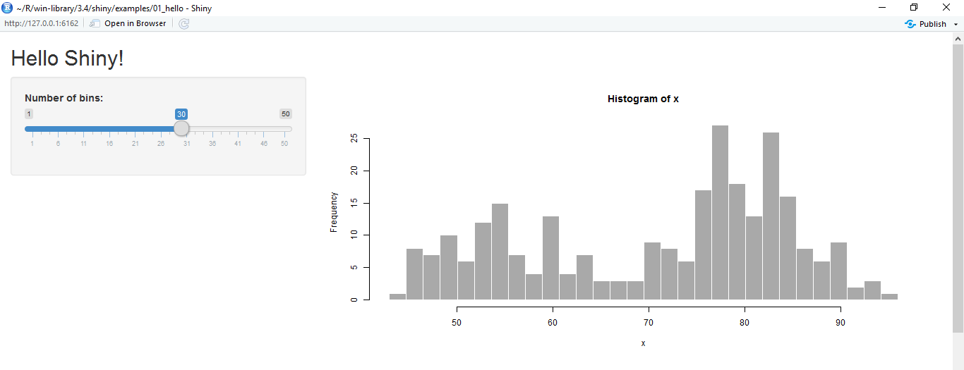
Basic Shiny Apps
Layout
Title/Header Panel
Sidebar/Input Panel
Main/Output Panel
You can create shiny apps with single file app.R or two files ui.R and server.R
ui.R
server.R
User Interface
Computation Processes

Slide 4
Shiny ui.R and server.R
ui.R
server.R
User Interface
Computation Processes
User Interface
Control the layout, appearance, widget for user inputs and display the output.
E.g. the title, page layout, text input, radio button, dropdown menu, graphics output etc.
Server
Set of instructions that uses the input provided by user, process them and produces the required output which is further displayed by ui.R

Slide 5
Shiny App – Multiple File
ui & server in separated file named ui.R and server.R but in the same folder
# file ui.R
library(shiny)
shinyUI(fluidPage(
........
)
)
# file server.R
library(shiny)
shinyServer(function(input, output <, session>){
........
}
)

Slide 6
Create the Brain
All processes are done in server.R.
All generated objects (vector, table, plot, text, UI etc.) based on input should be created in reactive function (reactive(), render*(), observe() etc.).
render*() → *Output()
ui.R | server.R
tableOutput("preview") | output$preview <- renderTable()
uiOutput("graphTitle") | output$graphTitle <- renderUI()
plotOutput("plots") | output$plots <- renderPlot()
printOutput("prints") | output$prints <- renderPrint()
textOutput("text") | output$text <- renderText()

Slide 7
Create Shiny App
Create Simple Shiny App

Slide 8
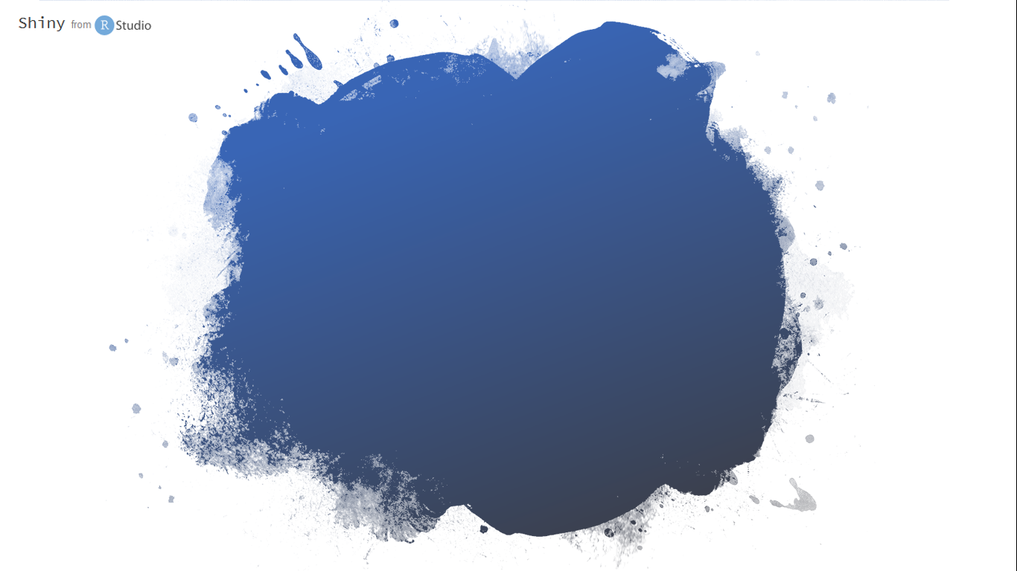
Programming is a skill best acquired by practice and example rather than from books.
-Alan Turing-

Slide 9

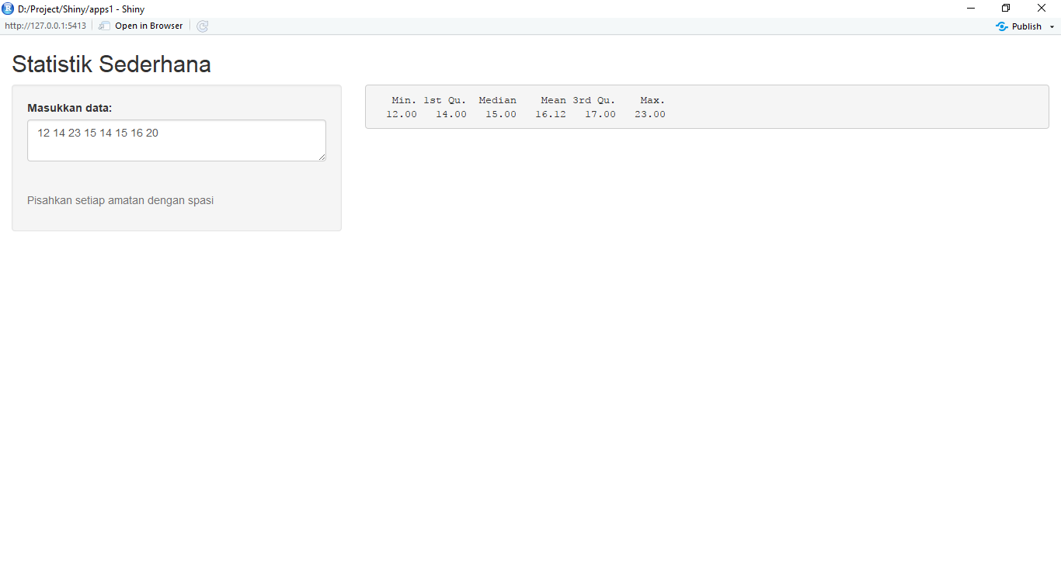
Example 1 - Simple Statistical Descriptive
Create an single file app (app.R) and multiple file to display statistical descriptive from the typed data.
You can use textInput() or textAreaInput() as input field.
Split data by space, convert list object as vector using unlist() and convert as numeric vector with as.numeric() function.
Last, compute simple statistics with summary() function.
The app’s full code is available on http://bit.ly/STCExp1

Slide 10
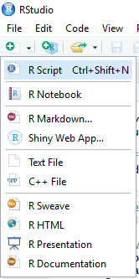
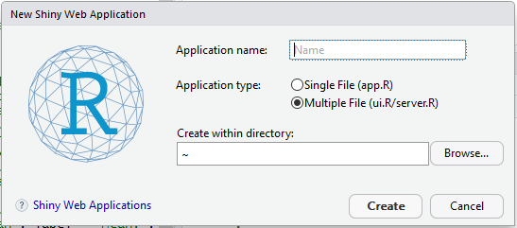
Using RStudio Menu
Create shiny apps template from RStudio
Provide Application name
Choose Single File (app.R) or
Multiple File (ui.R/server.R) for Application Type
Select folder for created shiny apps

Slide 11


